Slide 1
Fundamentals of CRE
Chemical Reaction Engineering
By
Dr Salah N. Farhan
Senior lecturer. Chem. Eng. Dept.
College of Engineering
University of Diyala
Salah N. Farhan College of Engineering Diyala University

Slide 2
Fundamentals of CRE
Chapter 9: Mole BalancesPressure Drop as a Function of Catalyst Weight in a Reactor
Salah N. Farhan College of Engineering Diyala University

Slide 3
Pressure Drop as a Function of Catalyst Weight in a Reactor

Slide 4
Pressure Drop as a Function of Catalyst Mass (w)
A_{c}
z
For a tubular reactor of cross-sectional area (A_{c}) and packed with a catalyst density (ρ_{c}) over a length z, the mass of the catalyst can be written as:
Differentiating the above equation, we get
or

Slide 5
Pressure Drop in terms of Catalyst Mass (W) – Cont.
Substituting,
into
We get
We do not yet have a differential equation for pressure in terms of conversion X

Slide 6
Pressure Drop in terms of Catalyst Mass (W) – Cont.
The pressure drop equation is
Recall,
where,
Also, we know that
Therefore,
F_{i} = f(X) and F_{T}= g(X)
ρ(X) denotes ρ is a function of X

Slide 7
Coupled Differential Equation for Packed Bed Reactors
f₂(P,T, X)
f₁(P,T, X)

Slide 8
Membrane Reactors

Slide 9
Membrane – Terminologies
Membrane: A material that allows selective permeation (or passing through) of certain molecules (species).
Permeate: The part of the fluid stream that passes through the membrane.
Retentate: The part of the fluid stream that does not pass through the membrane.
Permeate
Membrane
Feed
Retentate
Permeate
Schematic representation of a membrane separation process

Slide 10
Membrane Reactors – What and Why?
Usually in a chemical process, the separation of wanted and unwanted species are carried out in a separation vessel downstream of a reactor.
Membrane reactor allows the separation and reaction processes to occur simultaneously and in a single-vessel.
Catalytic membrane reactor can be used to increase the yields of products from reactions that are thermodynamically limited, i.e. from reversible reactions.
Catalytic membrane reactors can be classified into two categories:
  Inert Membrane Reactor with Catalyst on Feed Side
  Catalytic Membrane Reactor

Slide 11
Inert Membrane Reactor with Catalyst on Feed side (IMRCF)
Permeate
Membrane
Feed
Catalyst
Permeate
reaction is effected by the catalyst present as a pellet or packing.
membrane is inert and merely allows selective permeation of a particular species.
the feed side can be treated simply as a packed bed reactor

Slide 12
Catalytic Membrane Reactor (CMR)
Permeate
Membrane
Feed
Permeate
reaction occurs on the membrane surface which acts as a catalyst
membrane is not inert and allows both the selective permeation of a particular species and the reaction catalysis
the feed side can be treated simply as a plug flow reactor, if there are no packings.

Slide 13
Membrane Reactor: General Mole Balance
R_{C}
F_{B}
Reaction: C₃H₈ ↔ C₃H₆ + H₂
A B C
F_{A}
F_{C}
Membrane is permeable to C only
GMBE on A
GMBE on B
GMBE on C
R_{C} = rate of permeation

Slide 14
Membrane Reactor: Permeation Rate
R_{C}
F_{B}
F_{A}
F_{C}
R_{C} = rate of permeation moles/cm³-s
= f (C_{A}) or f (P_{A})
Permeation rates are usually determined experimentally.
For example, hydrogen permeation through Palladium membrane is given by following equation:

Slide 15
Micro-Reactors

Slide 16
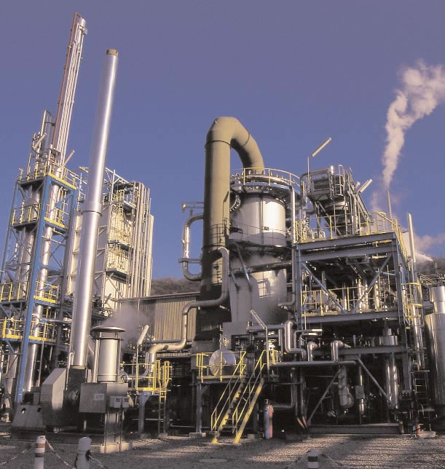
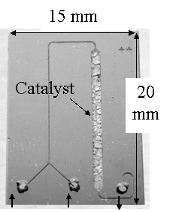
Micro-reactors: It is all about scale
20 m?
Conventional Chemical Plant
Microreactor

Slide 17
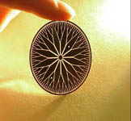
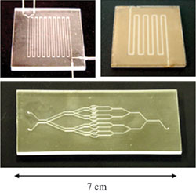
Micro-reactors: Introduction
Oregon State University—
Fractal MECS Devices
Generally, we mean:
  Fluid chemical reactants
  Microscale ducts, chambers
  High surface area/vol ratio
  Small volume flowrates
  Precise parameter control
Well-suited for:
  Small-scale output
  In-situ/portable reactors
  High efficiency (yield, thermal efficiency)
  High precision
  e.g., Lab-on-a-chip tech
Micro-Space Chemistry Lab– Various Microreactors

Slide 18
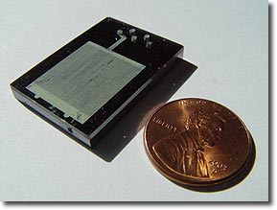
Micro-channel Reactors
Reacting mixture flows through the channels
Catalyst coated on channel surface
Salient features of micro-channel reactors
  High heat transfer rate
  High mass transfer rate
  Large reaction area per unit volume
  Low pressure drop

Slide 19
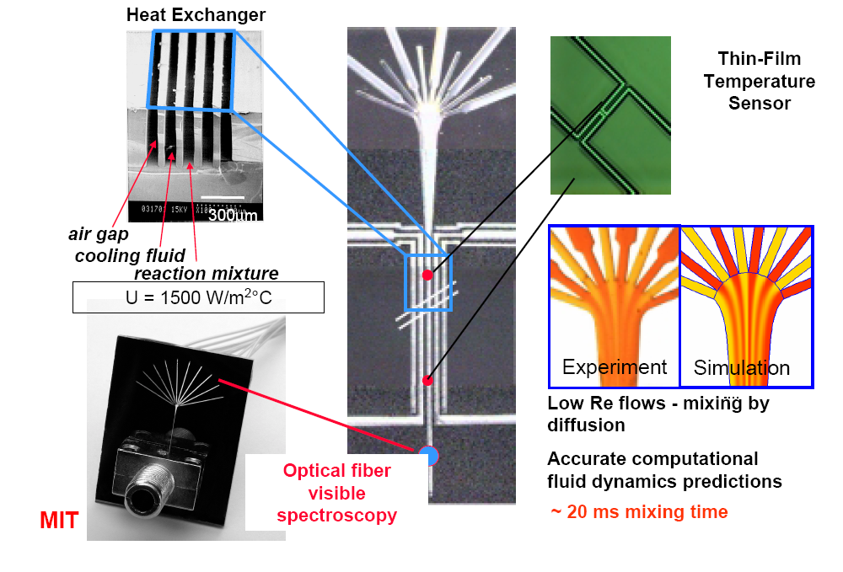
Micro-channel Reactors

Slide 20
Micro-Channel Development at
‘Karan Research Group’

Slide 21
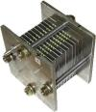
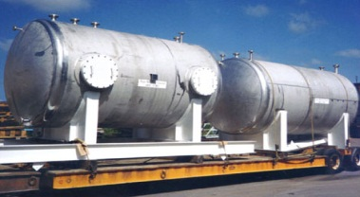
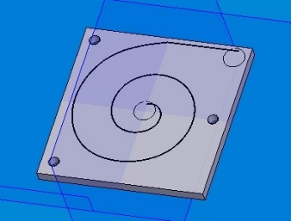
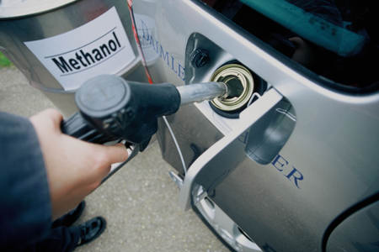
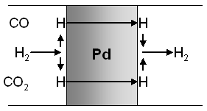
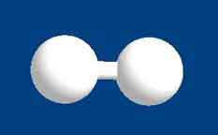
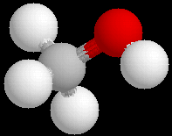


The Role of the Reactor
“From Well to Wheel”
Power to Application
Methanol
Supply
Small Fuel Cell
e.g. carbon recycling plant
Local Storage &
Transport
Separate
H₂
Reforming
Reactor
CH₃OH + H₂O → CO₂ + 3H₂
e.g. a small tank
e.g. palladium membrane

Slide 22
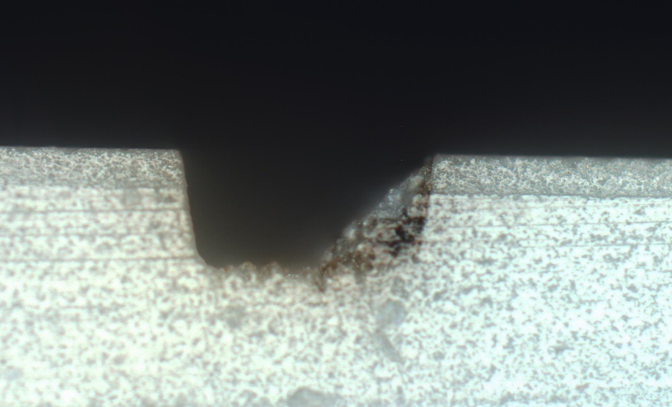
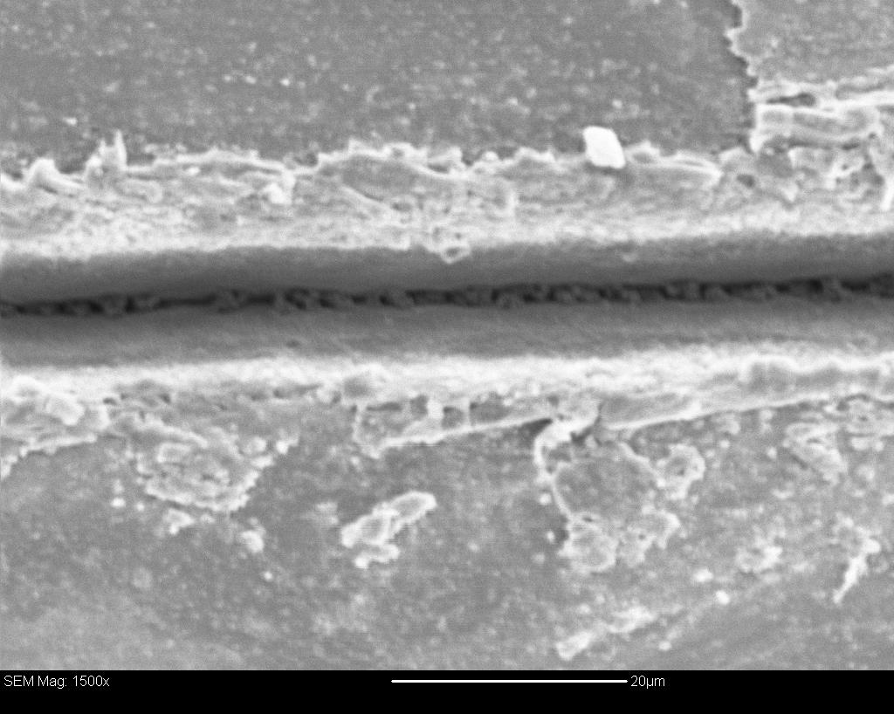
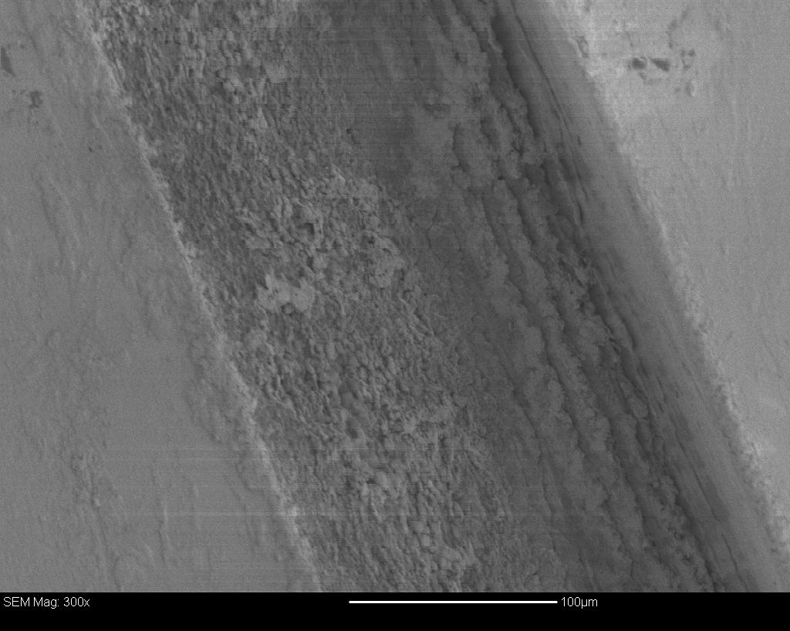
Micro-channel reactor: alumina substrate
30 μm
500 μm

Slide 23
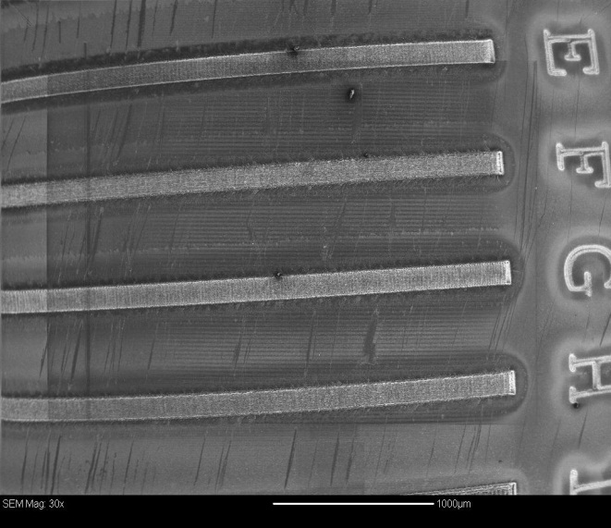
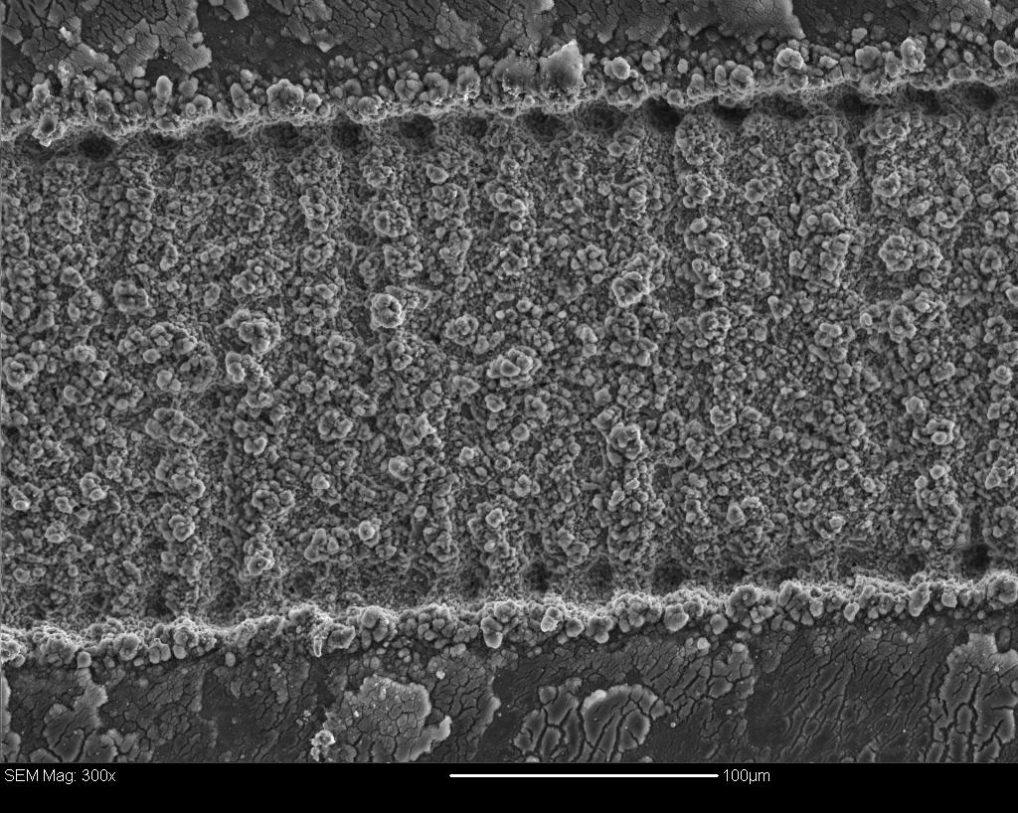
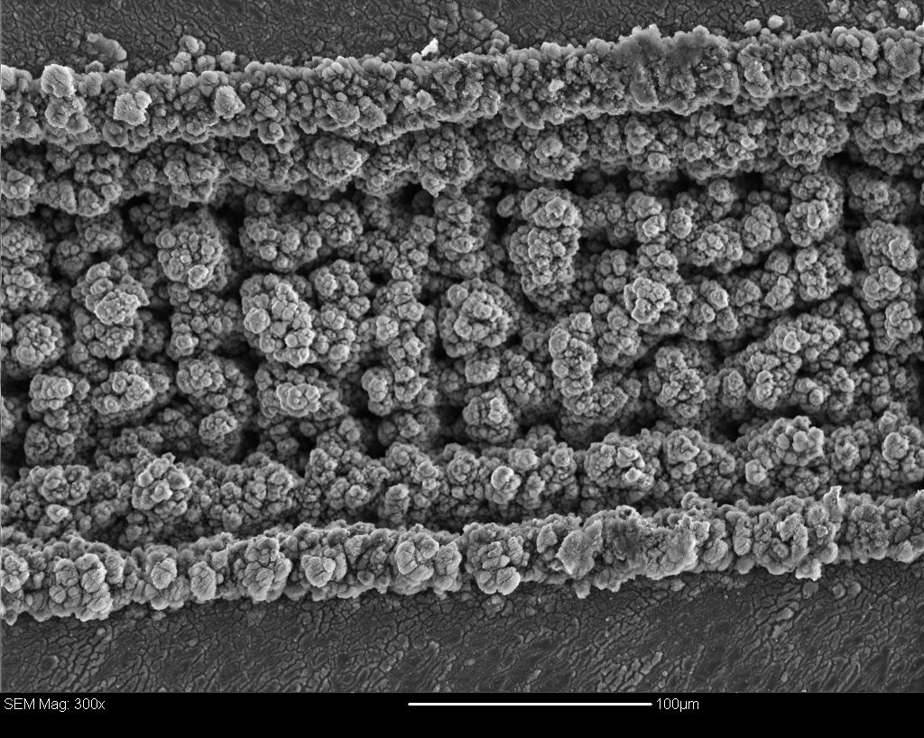
Micro-channel reactor: aluminium substrate

Slide 24
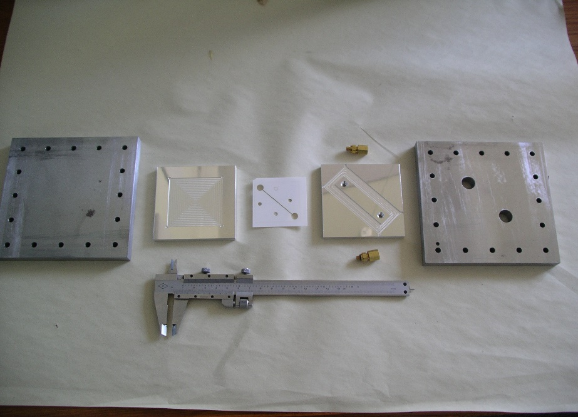
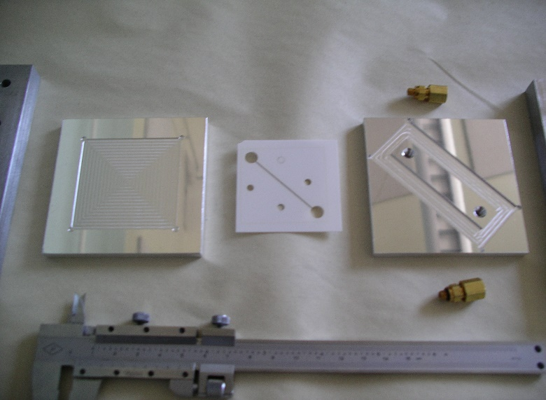
….Testing Catalyst Activity
Microchannel reactor assembly
Microchannels on a wafer

Slide 25
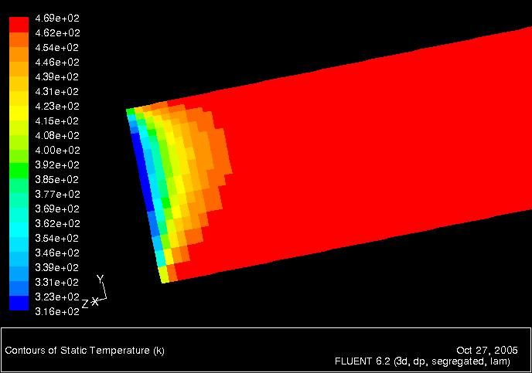
Computational Modelling
(Above) Fluid at room temperature enters a heated microchannel and reaches target T=470K in ~10μm.
(Above) Fluid enters microchannel and reaches fully developed (FD) flow in ~10 μm.
Computational simulations have been run to predict channel flow.
Results generally show reactants are quick to reach target temperature.
(Above) Results show flow development in a cross-section of a channel inlet.

Slide 26
GMBE for a Catalyst Coated Microchannel Reactor
Feed
Catalyst Coating
Square X-Section
Circular X-Section
Derivation to be provided in class

Slide 27
Semi-Batch Reactors

Slide 28
Semi-Batch Reactors
B
C
heat
A
A, B
B is slowly fed to A contained in the reactor.
Unwanted products can be minimized
exothermic reaction can be carried out at controlled rate
Product C is continuously removed
Higher conversion for reversible reactions can be obtained

Slide 29
Selectivity and Yield (Chapter 6)
Instantaneous Global
Selectivity
Yield
Example
Desired Reaction: A + B → D
Undesired Reaction: A + B → U
B
A
We can use
a semi-batch reactor
to maximize selectivity

Slide 30
Semi-Batch Reactors - GMBE
Reactant that starts in the reactor is always the limiting reactant
There are 3 forms of General Mole Balance Equations for Semi-Batch Reactors
GMBE expressed on a molar basis
GMBE expressed on a concentration basis
GMBE expressed on a conversion basis

Slide 31
Semi-Batch Reactors - GMBE
1. GMBE on a molar basis
Input - Output + Gen = Accu.
For Species A
F_{BO}
v_{O}
B
Constant Density Systems
For Species B

Slide 32
Semi-Batch Reactors - GMBE
2. GMBE on a concentration Basis
F_{BO}
v_{O}
B
Input - Output + Gen = Accu.
For Species A
⇒
Constant Density Systems
Similarly for Species B

Slide 33
Semi-Batch Reactors – GMBE
3. GMBE on a conversion Basis
Input - Output + Gen = Accu.
F_{BO}
v_{O}
B
Defining conversion for reactant that is being added (in our case - B) is tricky and perhaps not meaningful.

Slide 34





Fundamentals of CRE
Consider the general equation
The basis of calculation is always the limiting reactant. We will choose A as our basis of calculation
and divide through by the stoichiometric coefficient to put everything on the basis of "per mole of A".
The conversion X of species A in a reaction is equal to the number of moles of A reacted per mole of A fed.
Conversion | top
Batch | Flow
Salah N. Farhan College of Engineering Diyala University

Slide 35


Fundamentals of CRE
What is the maximum value of conversion?
For irreversible reactions, the maximum value of conversion, X, is that for complete conversion, i.e. X=1.0.
For reversible reactions, the maximum value of conversion, X, is the equilibrium conversion, i.e. X=X_{e}.
Batch | Flow
Moles A remaining = N_{A} = Moles A initially - Moles A reacted | Rate of Moles of A leaving F_{A} = Rate of Moles of A fed - Rate of Moles of A reacted
N_{A}= N_{A0} - moles A initially * (moles A reacted)/(moles A fed) | F_{A}= F_{A0} - Rate of moles A fed * (moles A reacted)/(moles A fed)
Salah N. Farhan College of Engineering Diyala University

Slide 36
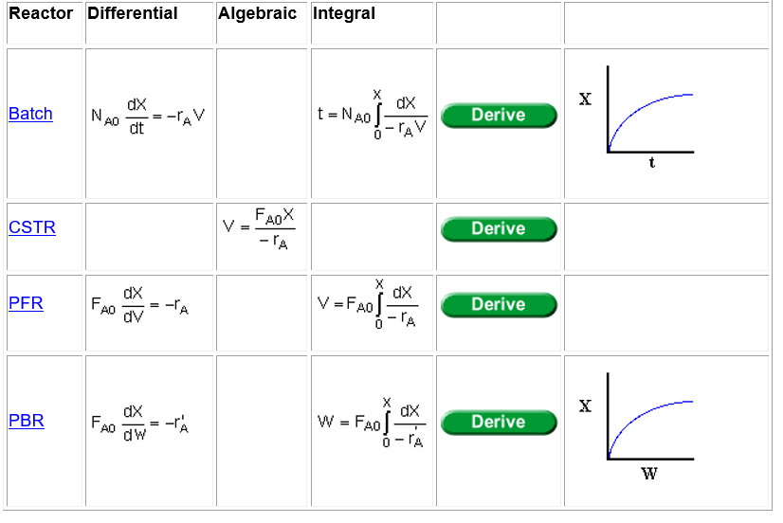
Fundamentals of CRE
Design Equations
The design equations presented in Chapter 1 can also be written in terms of conversion.
The following design equations are for single reactions only. Design equations for multiple reactions
will be discussed later.
Salah N. Farhan College of Engineering Diyala University

Slide 37
Fundamentals of CRE
Salah N. Farhan College of Engineering Diyala University

Slide 38
Fundamentals of CRE
Salah N. Farhan College of Engineering Diyala University

Slide 39
Fundamentals of CRE
Salah N. Farhan College of Engineering Diyala University

Slide 40
Fundamentals of CRE
Salah N. Farhan College of Engineering Diyala University

Slide 41
Fundamentals of CRE
Salah N. Farhan College of Engineering Diyala University

Slide 42
Fundamentals of CRE
Salah N. Farhan College of Engineering Diyala University

Slide 43
Fundamentals of CRE
Salah N. Farhan College of Engineering Diyala University

Slide 44
Fundamentals of CRE
Salah N. Farhan College of Engineering Diyala University

Slide 45
Fundamentals of CRE
Salah N. Farhan College of Engineering Diyala University

Slide 46
Fundamentals of CRE
Salah N. Farhan College of Engineering Diyala University

Slide 47
Fundamentals of CRE
Salah N. Farhan College of Engineering Diyala University

Slide 48
Fundamentals of CRE
Salah N. Farhan College of Engineering Diyala University

